Slide 1
Quantum Key Distribution

Slide 2
</ Table of contents />
{01}
{04}
Quantum Key Distribution
Qubit Error Rates
{02}
{05}
BB84 Protocol
Error Correction
{03}
{06}
Our Protocol
Conclusions & Future Work
Notes:
This is a roadmap of our presentation. We’ll start off with explaining the basics of quantum cryptography, followed by the BB84 protocol, and then our protocol. We will then compare the results of these two protocols and show our work about error correction using the three parity machine. Lastly, we will discuss our conclusions and future work.

Slide 3
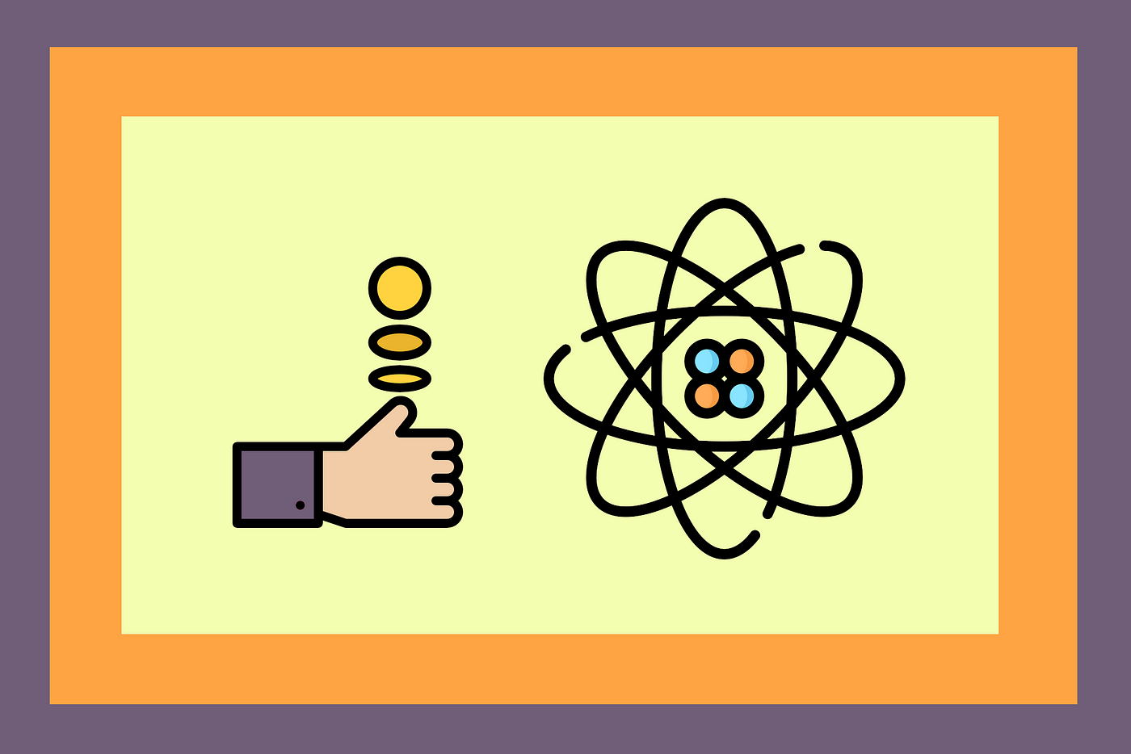
Quantum Data vs. Classical Data
Quantum Data
Classical Data
Qubits: fluctuates between 0 and 1
- Need to perform a measurement to get classical data
- Based on the spin of a photon
- Only ~400 qubits on the most powerful quantum computer
Bits: 0 or 1
- Used in everyday life
- All computers use bits to store information
Notes:
Slide 3:
From computers to calculators, information in all our everyday devices is stored in bits, which represent 0s or 1s. Using the principles of quantum physics, the first quantum computer was created in 1988. It stored information in qubits, a quantum computer’s basic unit that fluctuates between 0 and 1 with time and space. A qubit is based on the spin of a photon, which can only be obtained through a measurement. Some qubits contain equal probabilities of both 0 and 1, such that it is measured as 0 half the time and 1 the other half. Currently, the most powerful quantum computer at IBM can store around 400 qubits of information, which is still very little compared to traditional computers.

Slide 4
Public vs. Private Communication
Shared openly, lacks encryption
Vulnerable to interception
Efficient for broadcasting information
Encrypted, requires decryption key
Enhanced security, limited access
Suitable for sensitive data transmission
Notes:
Slide 4:
Public Communication:
Public communication involves sharing information openly without encryption, which can lead to security vulnerabilities. This means that any transmitted data is accessible to anyone who intercepts it, risking data exposure and unauthorized access. Without encryption, sensitive information becomes susceptible to eavesdropping and compromise. Public communication is efficient for broadcasting information to a wide audience, making it suitable for announcements or updates. However, caution is needed when transmitting sensitive data through these channels to prevent unintended exposure.
Private Communication:
In contrast, private communication utilizes encryption, requiring a decryption key for access. Encryption ensures that even if data is intercepted, it remains unreadable without the proper key. This enhanced security approach limits access to authorized parties, significantly reducing the risk of data breaches and unauthorized data exposure. Private communication methods, like encrypted emails and secure messaging apps, are ideal for transmitting sensitive information, ensuring protection and compliance with data privacy regulations. By leveraging private communication, organizations can maintain the confidentiality of sensitive data and uphold data privacy standards.

Slide 5
Quantum vs Classical Cryptography
Classical Cryptography
Quantum Cryptography
Dependent on computational complexity
- Fast Quantum/Super computers beat this protocol easily
Mathematically proven that protocol is secure
Eve can be detected with probabilities near one
Notes:
Quantum cryptography is becoming increasingly researched, due to the inherent problems of classical cryptography. Classical cryptography relies on the fact that a certain operation is too computationally complex. If an eavesdropper, commonly called Eve, completed the operation over the time limit, the protocol would stop, preventing the hacking. But this doesn’t work when powerful quantum computers or supercomuters are established, because these can complete the operations much much faster. On the other hand, it can be mathematically proven that quantum cryptography protocols are secure, not depending on computational complexity. The protocol can also detect eve with probabilities close to one for a certain amount of bits.

Slide 6
Quantum Key Distribution: BB84 Protocol
QKD Protocol
1
Enables secure communication using quantum properties
Encoding the Bits ^{[1]}
2
Transmission
Secret bit 0/1: Encoded as (|0⟩ or |1⟩)
Secret bit 0/1: Encoded as (|+⟩ or |-⟩) (Hadamard Basis)
Alice sends qubits to Bob through the quantum channel
3
4
Meas. and Basis Choice
Bob measures qubits in random bases
Two bases: Standard and Hadamard
Notes:
Slide 6:
The BB84 protocol, named after its inventors Charles Bennett and Gilles Brassard in 1984, is a quantum key distribution (QKD) protocol designed to enable secure communication between two parties, traditionally named Alice (the sender) and Bob (the receiver). The protocol ensures secure key exchange using the principles of quantum mechanics and the properties of qubits (quantum bits). The security of the protocol relies on the fundamental properties of quantum physics, particularly the Heisenberg uncertainty principle.
The following’s an explanation of the encoding process in the BB84 protocol using a tree map:
2. Preparation of Quantum States:
Alice prepares a sequence of qubits (A and B), each representing a bit of the secret key. Each qubit is in one of two possible quantum states: either the "0/1" state or “+/-”. However, due to the principles of quantum superposition, these states are not fixed until measured. For each bit of the secret key, Alice prepares a qubit in one of two possible states:
- If the measurement bit (B) is "0", she prepares the qubit in the standard basis, which can be represented as |0⟩ (ket-0) or |1⟩.
- If the measurement bit (B) is "1", she prepares the qubit in the Hadamard basis, which is a superposition of |0⟩ and |1⟩ states. This is represented as (|+⟩ or |-⟩).
3. Transmission:
After encoding each qubit with a random choice of basis and state, Alice sends these qubits to Bob through the communication channel. The channel could be optical fibers or any other medium that can transmit quantum states.
4. Measurement and Basis Choice:
Upon receiving the qubits, Bob performs a series of measurements on each qubit. He randomly selects one of the two bases to measure each qubit:
- The standard basis {|0⟩, |1⟩}.
- The Hadamard basis {|+⟩ = (|0⟩ + |1⟩) / √2, |-⟩ = (|0⟩ - |1⟩) / √2}.
Importantly, Bob doesn't know which basis Alice used to encode each qubit.

Slide 7
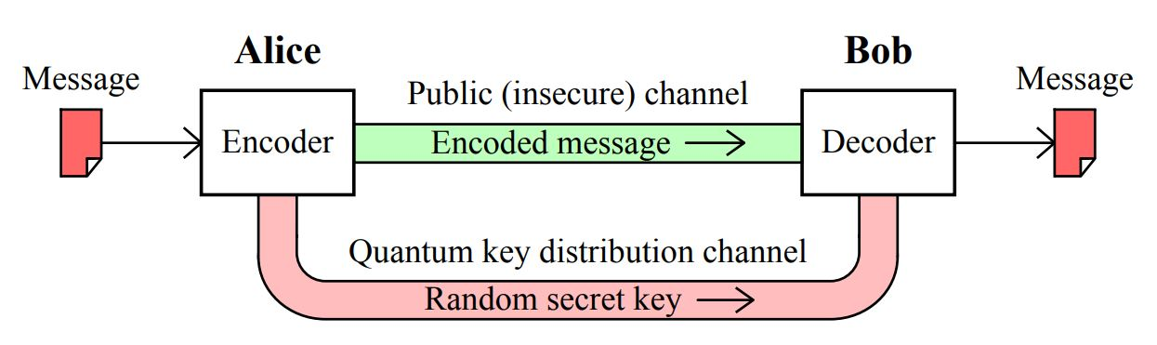
BB84 Protocol - Measuring
Ann. of Bases
5
Bob and Alice exchange bases for measurement and encoding
Filtering and Key Ext.
6
Error Est. & Priv. Amp.
Discard qubits with mismatched bases
Remaining qubits form raw key bits
Compare raw key bits publicly
Estimate error rate
Apple privacy amplification to distill secure final key
7
Security^{[2]}: Relies on quantum uncertainty and entanglement, making eavesdropping extremely difficult without detection.
Notes:
Slide 7:
6. Announcement of Bases:
After Bob has measured the qubits, he communicates with Alice over a classical communication channel to reveal the bases he used to measure each qubit. Alice also informs Bob about the bases she used to encode the qubits.
7. Filtering and Key Extraction:
Alice and Bob now discard the qubits for which they used different bases during encoding and measurement. The remaining qubits, for which their basis choices match, form the raw key bits. These bits are used to establish a shared secret key.
8. Error Estimation and Privacy Amplification:
To ensure security, Alice and Bob perform error checking and privacy amplification procedures. They publicly compare a subset of their raw key bits to estimate the error rate. Through a series of mathematical techniques, they can then distill a smaller, more secure subset of bits that form the final shared secret key.
The BB84 protocol's encoding process involves using quantum states and random basis choices to encode the bits, and the security of the protocol lies in the inherent uncertainty and entanglement properties of quantum mechanics, which make it extremely difficult for an eavesdropper (Eve) to gain information about the shared secret key without being detected.

Slide 8
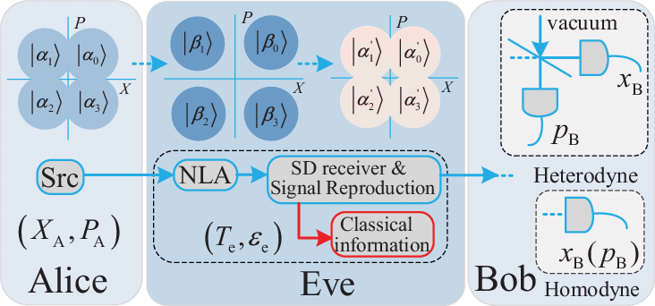
Intercept-Resend Attack
Definition: Unauthorized interception of data transmission followed by modified resend to recipient.
Objective: Manipulate or exploit data without sender/receiver knowledge.
Importance: Emphasizes channel security to prevent tampering and unauthorized access.
</>
Notes:
Slide 8:
An intercept-resend attack is a type of cyber attack where an unauthorized entity intercepts data being transmitted between two parties and then resends the data to its intended recipient after making unauthorized modifications. This attack aims to manipulate or exploit the data without the knowledge of the sender or receiver. It highlights the importance of securing communication channels to prevent data tampering and unauthorized access.

Slide 9
Citations
[1] https://learn.qiskit.org/course/ch-algorithms/quantum-key-distribution#quantum-71-2
[2] https://www.qmunity.tech/tutorials/quantum-key-distribution-with-bb84

